Slide 1

Battleship Game
Rajankumar Mandanka

Slide 2
Introduction
A browser-based Battleship game built using HTML, CSS, and JavaScript.
Players take turns placing ships and attacking each other's ships.
The game alternates between ship placement and attacks.
A simple UI with Bootstrap for a responsive layout.

Slide 3
Game Concept
Two players take turns:
Player 1: Places their ships.
Player 2: Attacks Player 1's ships.
The game ends when one player sinks all of the opponent’s ships.
Players can click on grid cells to place ships or attack.

Slide 4
Key Features
Grid Layout: Ships are placed on a 10x10 grid.
Ship Placement: Player 1 places ships on the grid.
Attack Phase: Player 2 attacks Player 1's ships.
Game Flow: Players alternate between ship placement and attacking.
Game Reset: A restart button after the game ends.
Result Display: Shows total hits and misses

Slide 5
Project Structure
HTML: Structure of the grid and buttons.
CSS: Styled using Bootstrap and custom styles.
JavaScript: Logic for ship placement, attacking, and game state management.
Battlefield Class: Manages grid and ships.
Game Logic Class: Handles game turns and logic.
Game Class: Initializes the game.

Slide 6
Code Structure
Battlefield Class:
Creates the battlefield of ships.
Handles ship placement and grid reset.
Game Logic Class:
Manages player turns, attacks, and game state.
Game Class:
Initializes the game and starts the game loop.

Slide 7
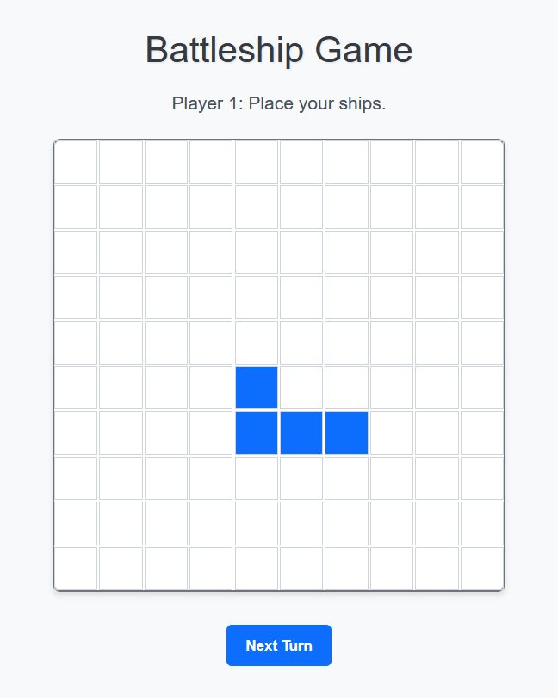
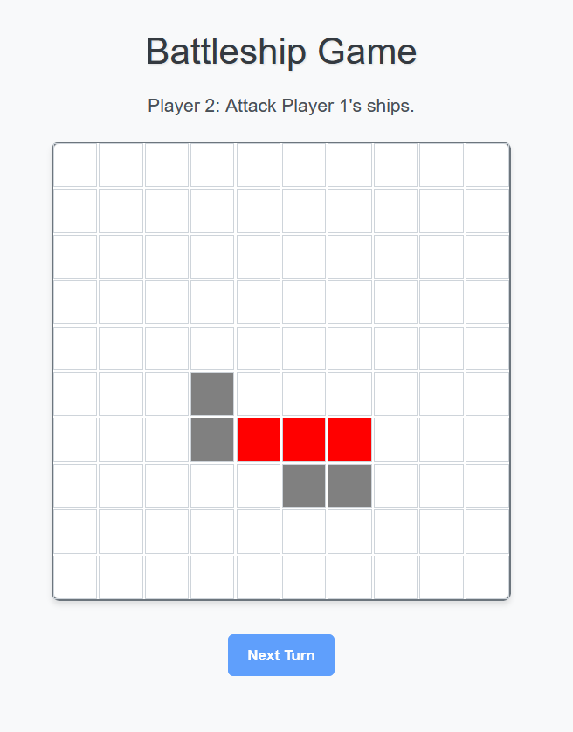
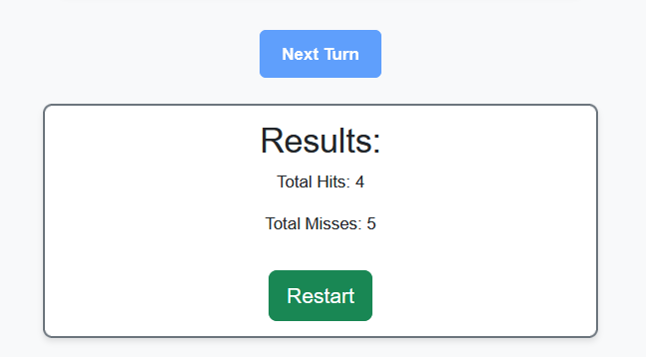
Interface

Slide 8
Challenges & Learnings
Handling alternating player turns in a clean way.
Implementing event listeners for game actions.
Managing game state (hits, misses, ships remaining).
Working with CSS grid layout and Bootstrap for a responsive design.

Slide 9
Thank you

